Slide 1
Podcasting
Podcasting: creating, editing & posting
Allen R. wazny, CPA/CA
4 March 2020

Slide 2
Podcasting Overview
Podcasting | An Introduction
Step 3: Creating a podcast
Popular sites
Gary Vaynerchuk
Step 4: Editing and posting your podcast
Editing tools
Social media: Twitter, FB, IG, LinkedIn
Automatic network posts

Slide 3
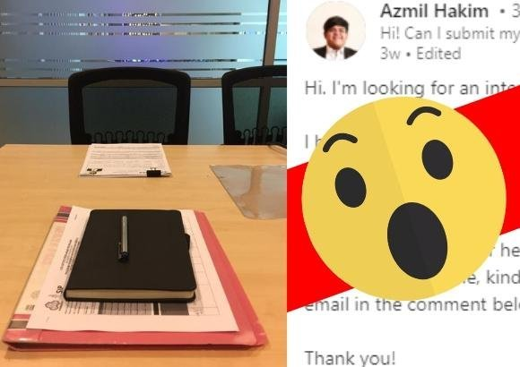
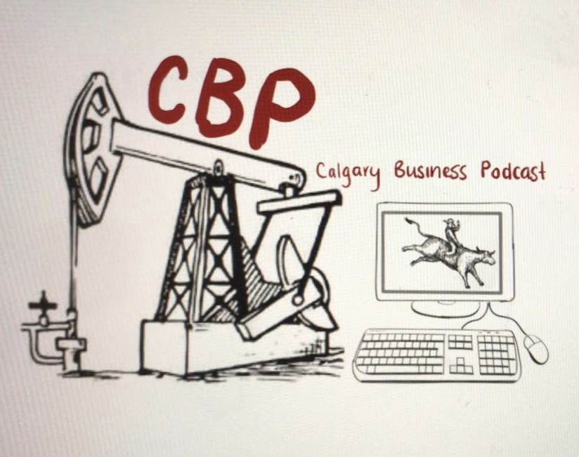
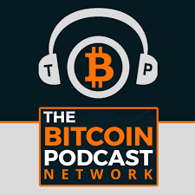
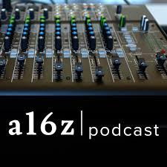
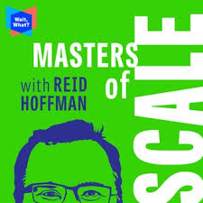
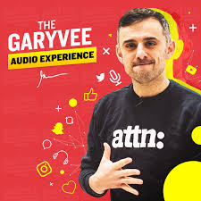
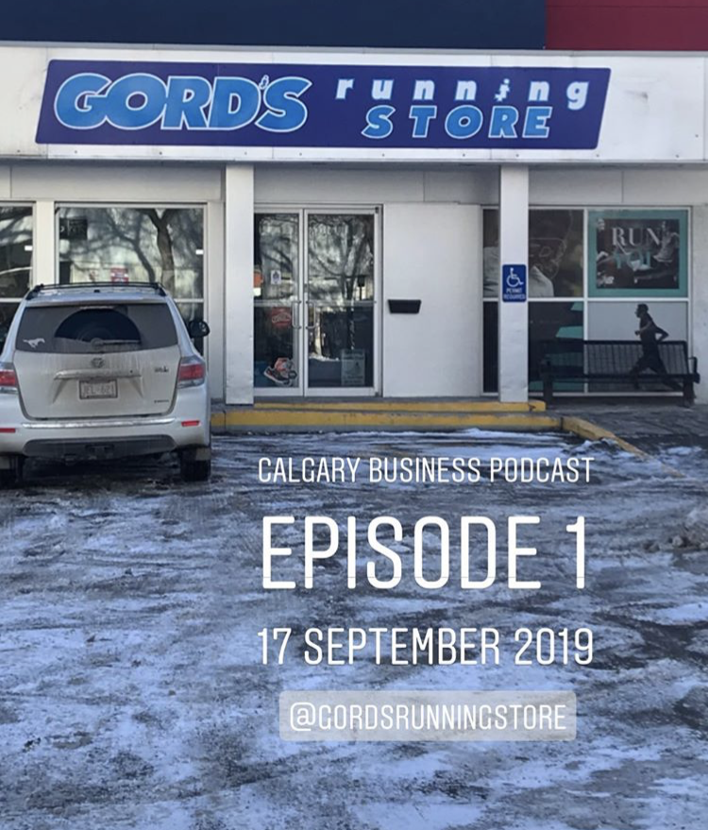
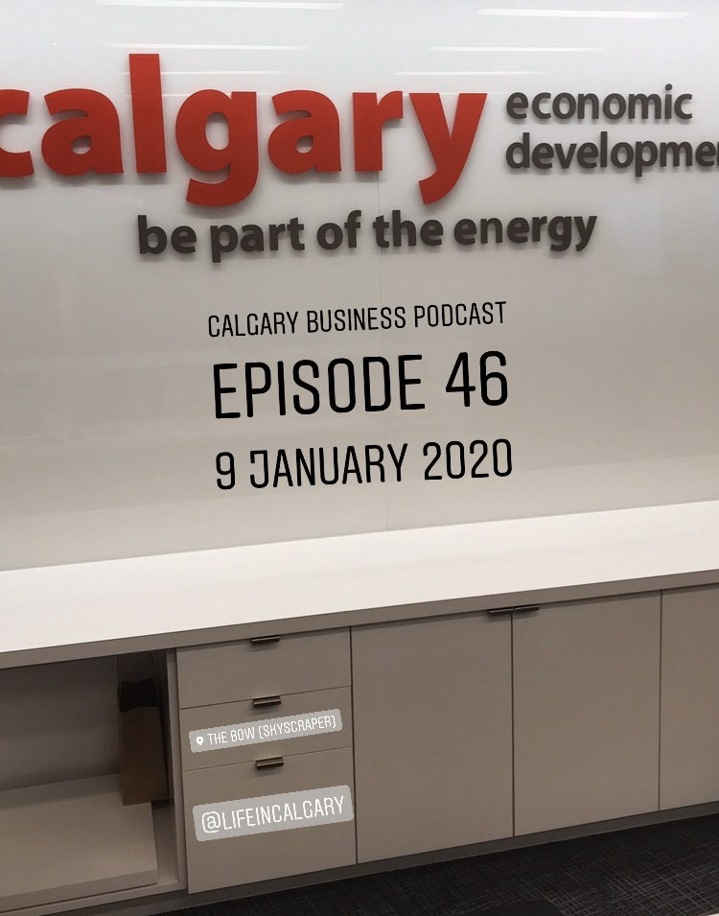
Podcasting | An introduction
From learning on Podcasts | To creating & sharing on Podcasts
July to December 2017 Podcasts to learn about blockchain, venture capital and business March 2018 Podcasts to learn about social media, branding & awareness | May 2019 “Will You Review My CV?” (total of 24 episodes) September 2019 “Calgary Business Podcast” (total of 76 episodes)

Slide 4
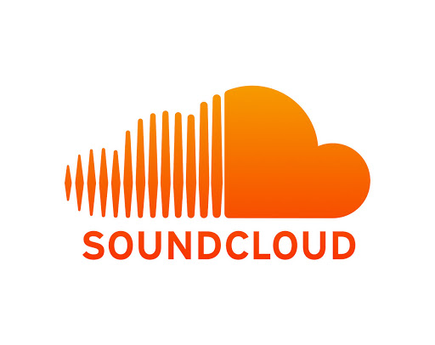
Step 3: Creating a Podcast Slide 1 of 3 Hosting sites
Anchor.FM | https://anchor.fm/ | Free
SoundCloud | https://soundcloud.com/ | Free to $16 / month
Buzzsprout | https://www.buzzsprout.com/ | Free to $24 / month
Podomatic | https://www.podomatic.com/ | Free to $60+ per month
FuseBox (Smart Podcast Player) | https://fusebox.fm/| Free to $8 per month

Slide 5
Step 3: Creating a Podcast Slide 2 of 3 Hosting sites – professional
Podbean| https://www.podbean.com/ | $29/month
Transistor | https://transistor.fm/ | $19 o $99 / month
Simplecast | https://simplecast.com/ | $15 to $85 per month
Captivate | https://my.captivate.fm/ | $19 to $99 per month
Libsyn | https://libsyn.com/ | $5 to $75 per month

Slide 6
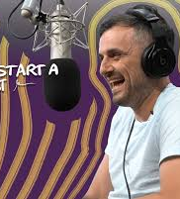
Step 3: Creating a Podcast slide 3 of 3 Gary Vaynerchuk
“How to Start A Podcast”
http://bit.ly/37IpyZb

Slide 7
Step 4: Editing a Podcast
Audacity
Audacity Tutorial: 17 Essential Podcast Recording & Editing Tips
https://www.buzzsprout.com/learn/audacity-tutorial
Audacity is free; works on Mac or PC
https://www.audacityteam.org
GarageBand
Available on Mac-Apple
Adobe Audition
Available from Adobe

Slide 8
Step 4: Podcast Distribution Slide 1 of 2
Spotify |https://podcasters.spotify.com
iHeartRadio | https://www.iheart.com/
Apple Podcasts | https://www.apple.com/ca/itunes/
Breaker | https://www.breaker.audio/
Overcast | https://overcast.fm/
PocketCasts | https://www.pocketcasts.com/
RadioPublic | https://radiopublic.com/
Stitcher | https://www.stitcher.com/
Google Podcasts | https://podcasts.google.com

Slide 9
Podcast | Posting & Distribution Slide 2 of 2
Gary Vaynerchuk
“How to make 64 pieces of content in 1 day”
PDF file -- 269 pages
Published 14 November 2019
Link: https://bit.ly/37sr9mf
“How to Grow and Distribute Your Brand”
PDF file -- 86 pages
Published February 2019
Link: http://bit.ly/2H0Jviz

Slide 10
Podcasting: It’s About the Content
5 Feb 2020: Spotify buys podcast publication, The Ringer, for nearly $200 million
CNBC: http://bit.ly/2uNa7BV
14 Feb 2019: Spotify paid $340 million for Gimlet Media and Anchor
Techcrunch: https://tcrn.ch/37BpIBH

Slide 11
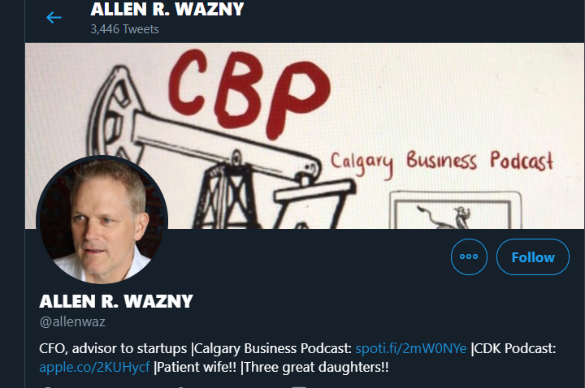
Thanks for your attention!!
Allen R. Wazny, CPA, CA
allenwaz@yahoo.ca
allen@solarnity.io
+1-403-506-8465 | Calgary
Skype | allenalmaty
LinkedIn | linkedin.com/in/allenwazny
Twitter | @allenwaz
Calgary Business Podcast
iHeart Radio | https://ihr.fm/2F84f7I
Spotify | https://spoti.fi/2mW0NYe
Will You Review My CV?
Spotify | https://spoti.fi/32b7plw
Apple | https://apple.co/2KUHycf

